Slide 1

Credit Risk Analysis Using Machine Learning Algorithms Github link : https://github.com/Credit-Risk-Analysis-Using-Boosting-Alg/A3_BATCH_2020
Batch No: A03 Project Guide:
P.Nandini 164G1A0558 Mr. Lingam Suman _{M.Tech}
M.Jaya sree 164G1A0532 Assistant Professor
P.Mounika 164G1A0556
M.Bhanu Prakash 164G1A0510
Srinivasa Ramanujan Institute of Technology
Department of Computer Science & Engineering

Slide 2
Abstract
Banking industry has the major activity of lending money to those who are in need of money. When a financial institute lends money to a customer, they are taking some kind of risk. Because the customer may repay or may not repay the money.
In our project we are using an algorithm which will generate an probability, this probability value will indicate the chances of borrowers defaulting. Defaulting means borrowers cannot repay their loan in a certain amount of time . If the borrower has high probability he can repay the money otherwise he cant repay the money.

Slide 3
Problem definition
The accurate assessment of consumer credit risk is of uttermost importance for lending organizations. Increasing the demand for consumer credit has led to the competition in credit industry. So Banking sectors have to develop and apply machine learning methods to handle analyzing credit data in order to save money and reduction of risk.

Slide 4
Existing System
In the existing system they are using the normal Classifying Algorithms to predict Credit Repaying nature of a customer.
The robustness of current traditional approaches is based on formalized hypothesis which are not capturing the fraud behavior of the Customer.
The distortions in the existing model is not easily identifiable.
This model is still far from attaining mature levels both at the methodological and at the credit granting , monitoring and control process.

Slide 5
Proposed System
In this proposed model we are building the models which will accurately predict the risk factor using the boosting algorithms using machine learning.
The main Advantages of this system is to:
Lend to right type of customers.
Monitor collections.
Predict and reduce delinquencies.
Reduce NPA and increase profitability.

Slide 6
Algorithms
Gradient Boost Algorithm :
Steps :
Calculate the average of the target label
Calculate the residuals
Construct a decision tree
Predict the target label using all of the trees with in the ensemble
Compute new residuals
Repeat step 3 and 5 until the number of iterations matches the number specified by the hyper parameter
Once trained, use all the trees in the ensemble to make a final prediction as to the value of the target variable.

Slide 7
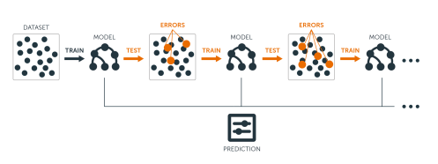
Overview of Gradient Boost Algorithm

Slide 8
Ada Boost Algorithm
Steps:
Initialize the sample weights
Build a decision tree with each feature, classify the data and evaluate the result
Calculate the significance of the tree in the final classification
Update the sample weights so that the next decision tree will take the errors made by the preceding decision tree into account

Slide 9
Contd…
5) Form a new dataset
6) Repeat steps 2 through 5 until the number of iterations equals the number specified by the hyper parameter (i.e. number of estimators)
7) Use the forest of decision trees to make predictions on data outside of the training set

Slide 10
Project planning
1. Loading the dataset
2. Exploratory data Analysis
a) Treating null and missing values
b) Treating Correlated variables
3. SMOTHE algorithm to over come imbalance data
4. Feature Importance
5. Data Splitting in to train and test datasets
6. Fitting data on different algorithms
7. Cross validation
8. Hyper parameter tuning
9. Feature transformation
10. Voting Ensemble methods
11. Out of time validation

Slide 11
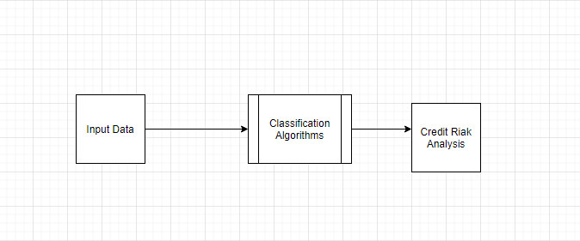
Data Flow Diagram
Level-0

Slide 12
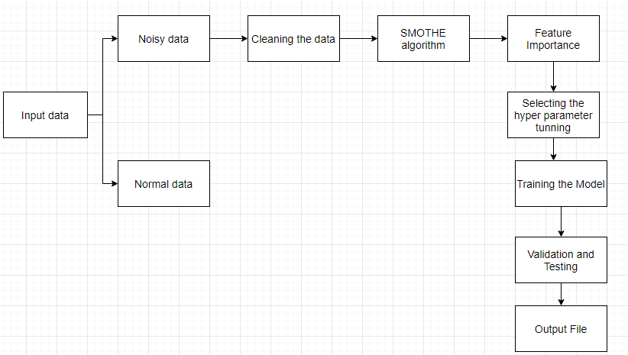
DFD(Level-1)

Slide 13
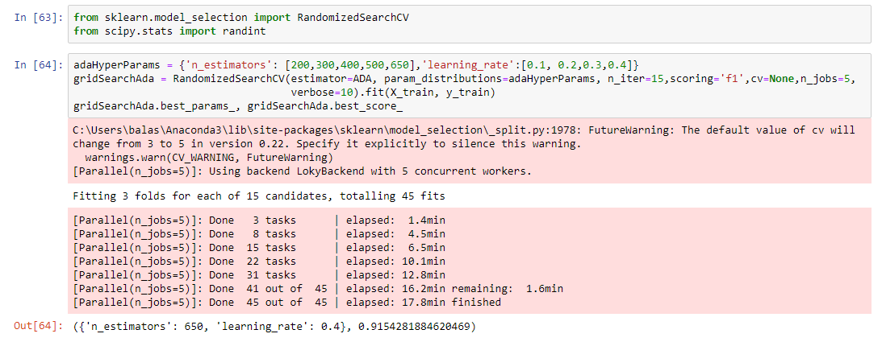
Implementation Code To Perform Hyper Parameter Tuning For Ada Boosting Algorithm

Slide 14
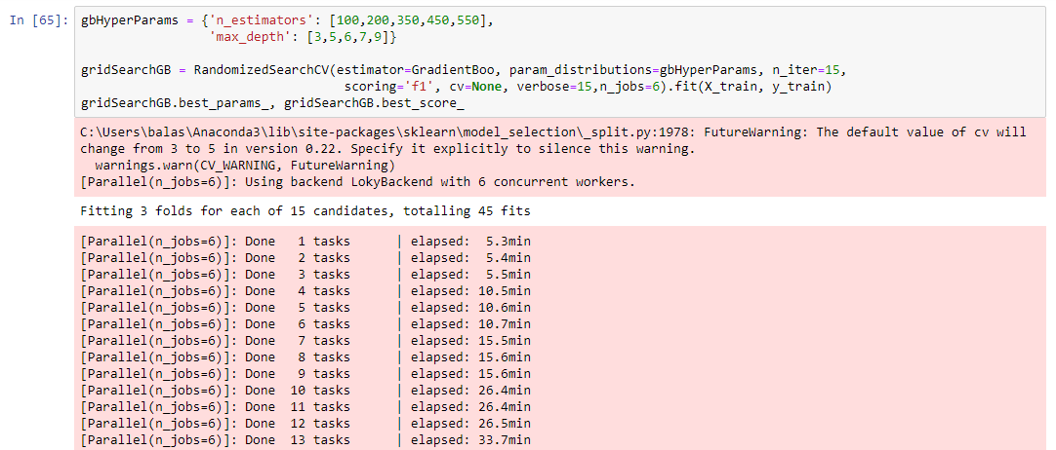
Code To Perform Hyper Parameter Tuning For Gradient Boosting Algorithm

Slide 15
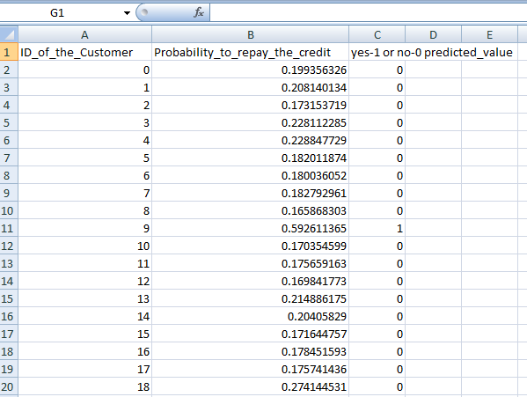
Project Output

Slide 16
Conclusion
By giving how much probability of each customer having to repay the money to the bank , it will help the bank and it will reduce their financial lose and the bank can came to know who are the customers can really repay the money.

Slide 17
Requirements
Tools used :
Jupyter notebook
Hardware Requirements :
RAM : 4 or 8 GB
Hard disk : 1 Tb
Software Required :
Jupyter Notebook
Programming Languages : Python

Slide 18
Literature Survey
Dhaiya, S., Singh, N.P., ‘Impact of Bagging on MLP classifier’, International Conferences On Computing For Sustainable Global Development, pp. 3794-3799. 2016.
Danenas,P., Grasva,G., ‘Selection Of Support Vector Machine Based Classifier For Credit Risk’, Expert System With Application , Vol. 42, pp. 3194-3204, 2015.
Credit Risk Analysis by using Machine Learning Classifier by TN Pandey - ‎International Conference on Energy, Communication, Data Analytics and Soft Computing (ICECDS-2017).

Slide 19
Thank you
Queries
?

